Slide 1
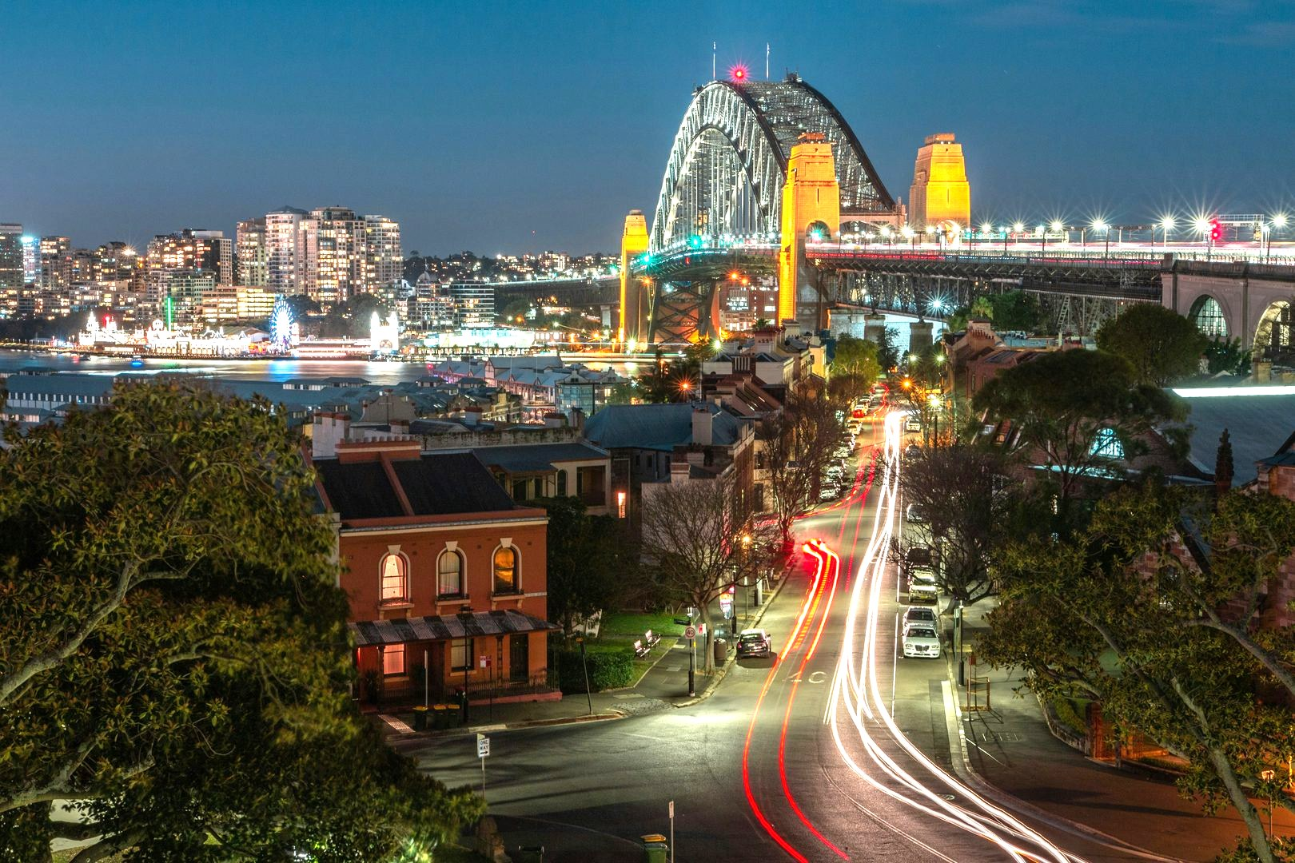
TIGHTROPE
A SYDNEY NOIR CRIME SERIES
CREATED BY MICHAEL EGAN
STU ARBURY | RAMO LAW | stu@ramolaw.com | (310) 284-3494

Slide 2
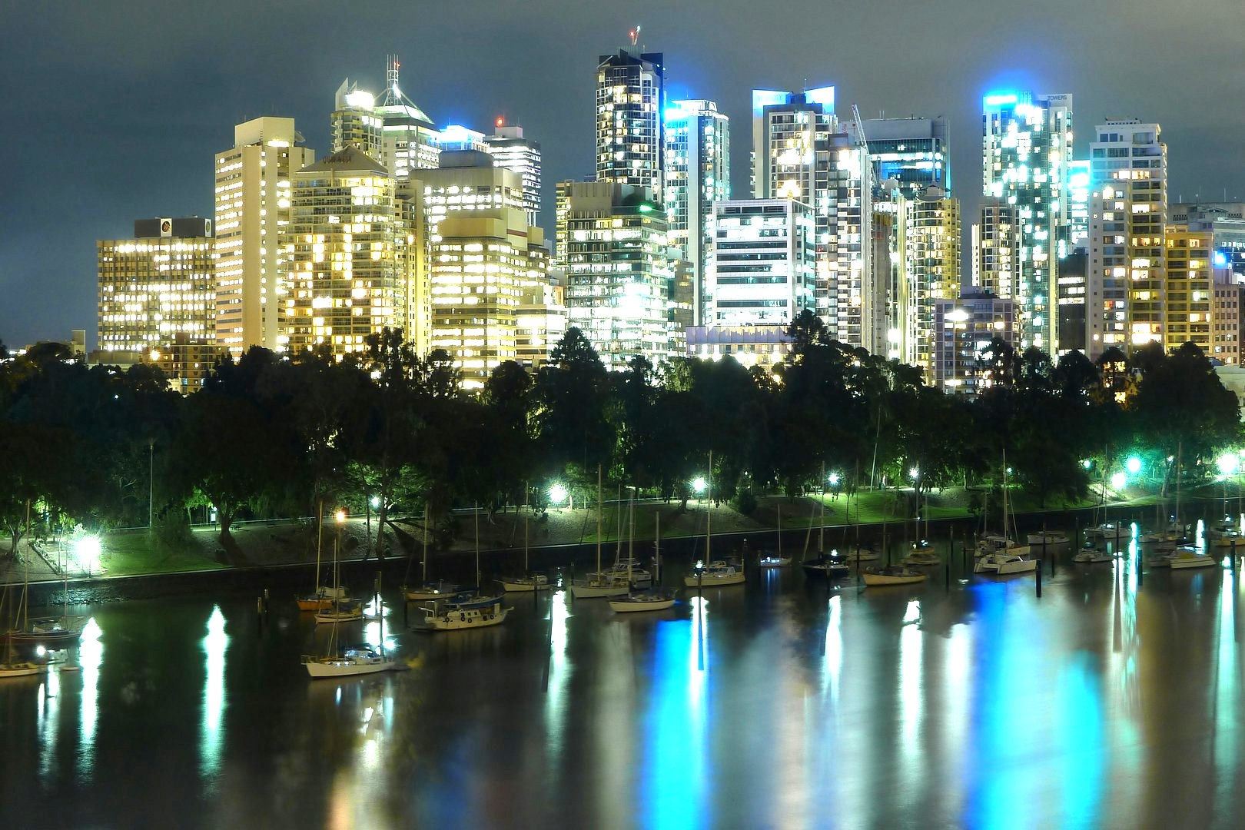
LOG LINE
Angela “Ange” Parrelli walks a tightrope: as a mother, she fights to keep her daughter. As a Sydney detective, she hunts a vigilante executing the sex offenders her city won’t convict.
TIGHTROPE
MICHAEL EGAN | SERIES CREATOR

Slide 3
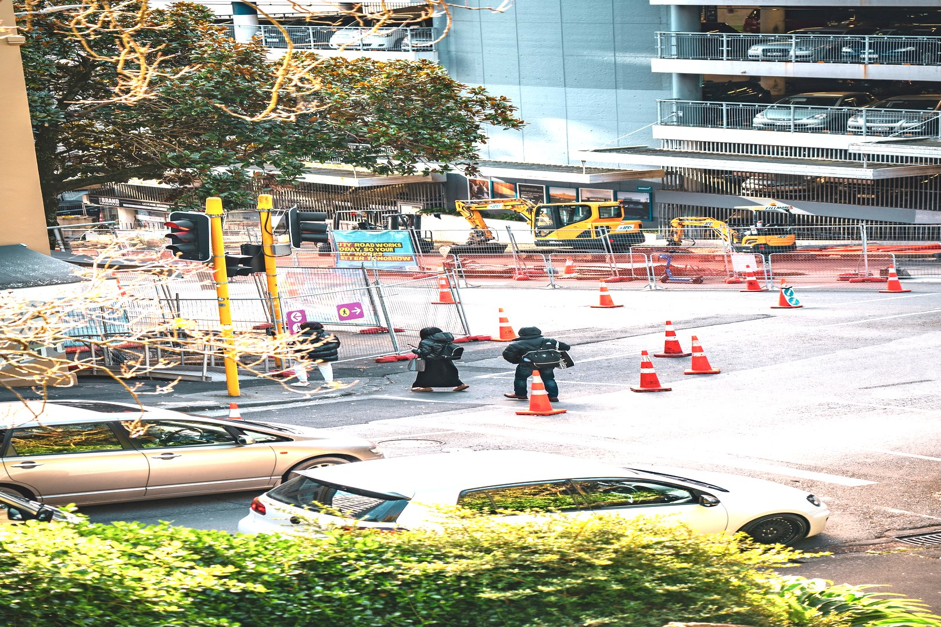
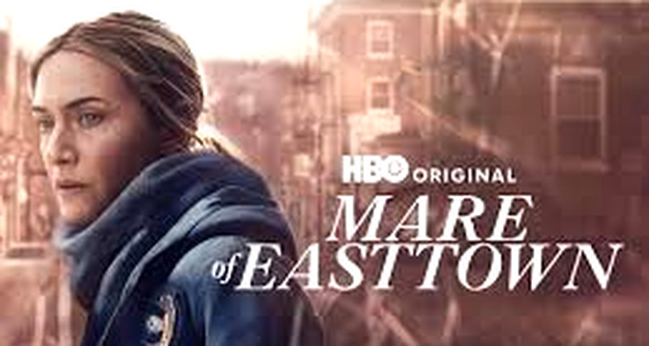
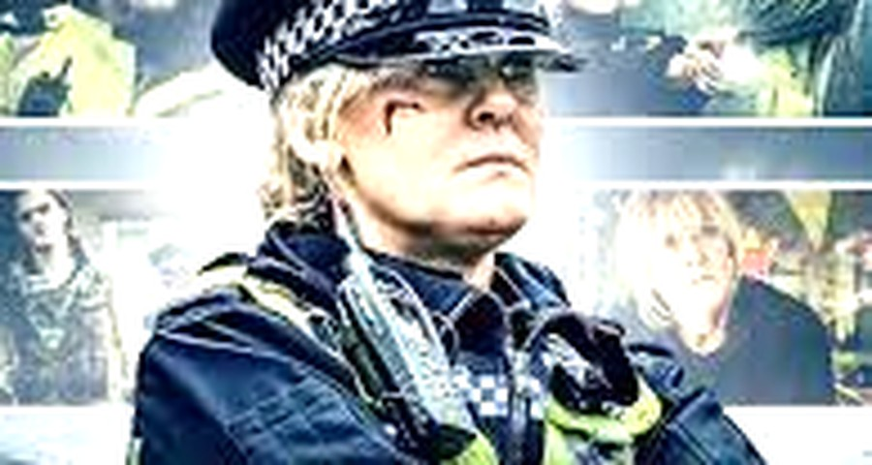
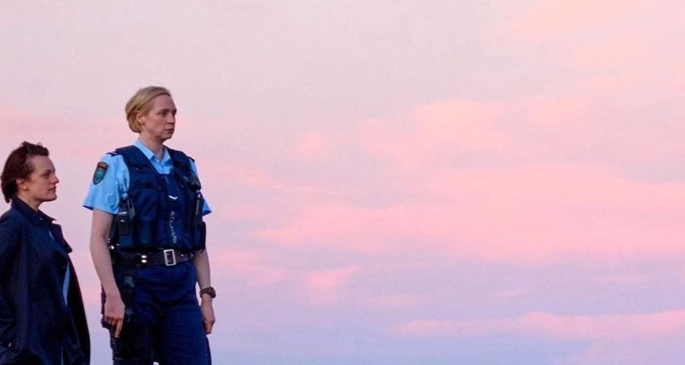
COMPARABLES
HBO
Kate Winslet · Emmy 2021
BBC ONE
Sarah Lancashire · BAFTA
BBC · SUNDANCE
Jane Campion · Elizabeth Moss
MARE OF EASTTOWN
HAPPY VALLEY
TOP OF THE LAKE
Female-led detective procedural grounded in grief, working-class community and layered mystery. Earned, humane storytelling.
Uncompromising female detective, Yorkshire noir, psychological depth. Refuses to flinch. Family trauma as series engine.
Female detective pursuing systemic abuse amid an atmospheric Southern-Gothic landscape. Auteur vision, Antipodean grit.
TIGHTROPE sits at the intersection of all three.
MICHAEL EGAN | SERIES CREATOR

Slide 4
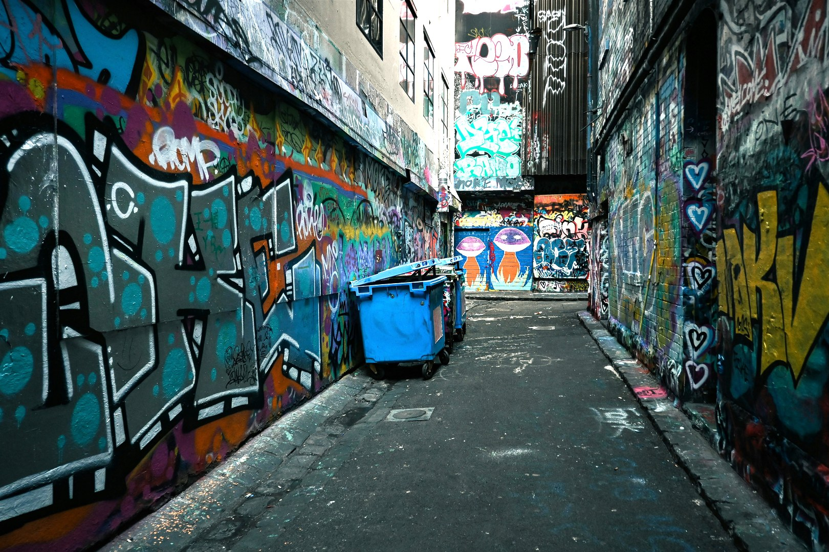
PILOT SYNOPSIS
Detective Angela Parrelli is barely holding it together. She is fighting a brutal custody battle against her abusive ex-husband DWAYNE MADDOX, quietly using cocaine to stay upright — and now she has Sydney’s most baffling case: a shooter on a black Ducati executing men whose sexual assault charges collapsed before trial, leaving a gold-printed “Guilty” card at each scene.
As the bodies mount, Maddox weaponises Parrelli’s chaotic life and Judge CLAUDIA KAMINSKI awards him full custody of four-year-old Jessica. Then the Vigilante saves Parrelli’s life at a stakeout, cradling her bruised face before riding off — tender, almost maternal. When every victim traces to the same courtroom, a park killing delivers the reveal: Kaminski flips up her visor and rides into the dark. Off the case and stripped of her daughter, Parrelli walks back in anyway.
MICHAEL EGAN | SERIES CREATOR

Slide 5
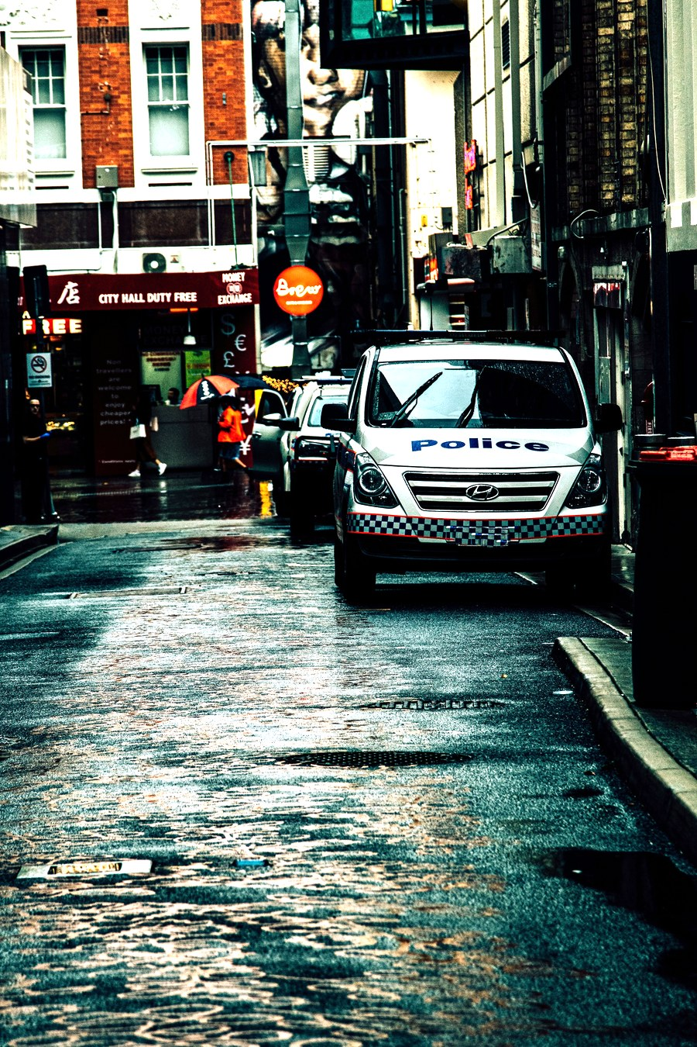
SETTINGS
TWO SYDNEYS
REAL GEOGRAPHY
Postcard landmarks against the criminal underbelly visitors never see
Parramatta Road, Waterloo — recognisable, unglamorous Sydney
THE PROCEDURAL SPINE
NOCTURNAL PALETTE
Law offices, precincts, the morgue, ballistics, St Vincent’s A&E
Refinery tanks, wire mesh, dawn streets — domestic life punctured by violence
STREET LEVEL
The Foundry nightclub, grimy car parks, Kurnell’s industrial waterfront
MICHAEL EGAN | SERIES CREATOR

Slide 6
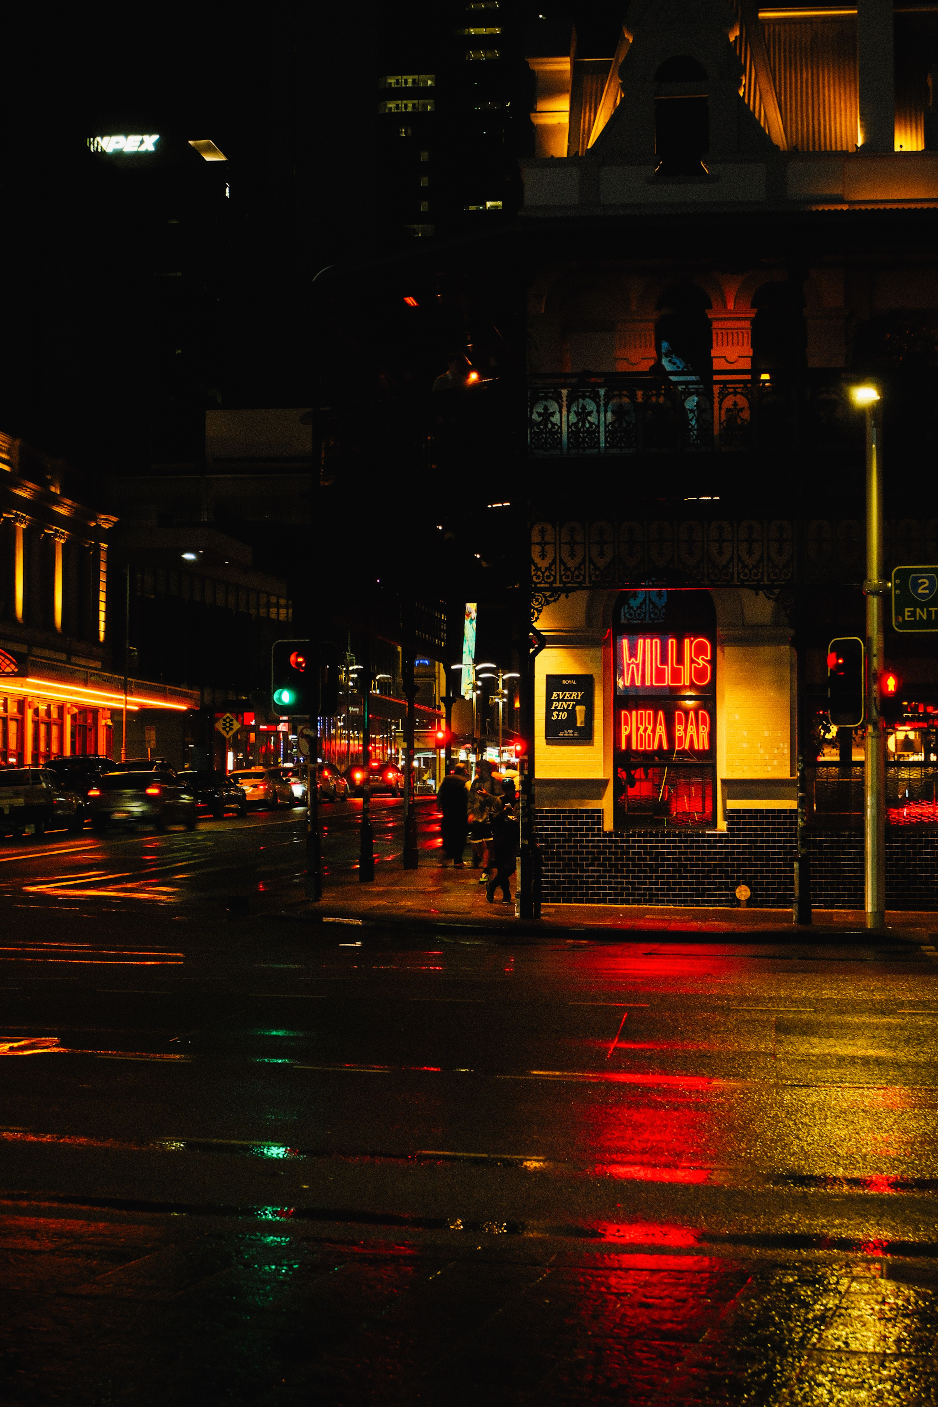
TONE AND STYLE
"Sharp. Funny. Tragic.
Dangerous — often within the same scene."
CINEMATIC NOIR
Handheld intensity, neon accents, wide shots of Sydney's sprawl
PROCEDURAL GRIT
Hard-boiled detective work grounded in authentic Sydney police culture
SOCIAL COMMENTARY
Systemic failure, vigilante justice, and the cost of institutional corruption
BLACK HUMOUR
Ange's caustic wit cuts through even the darkest moments
MICHAEL EGAN | SERIES CREATOR

Slide 7
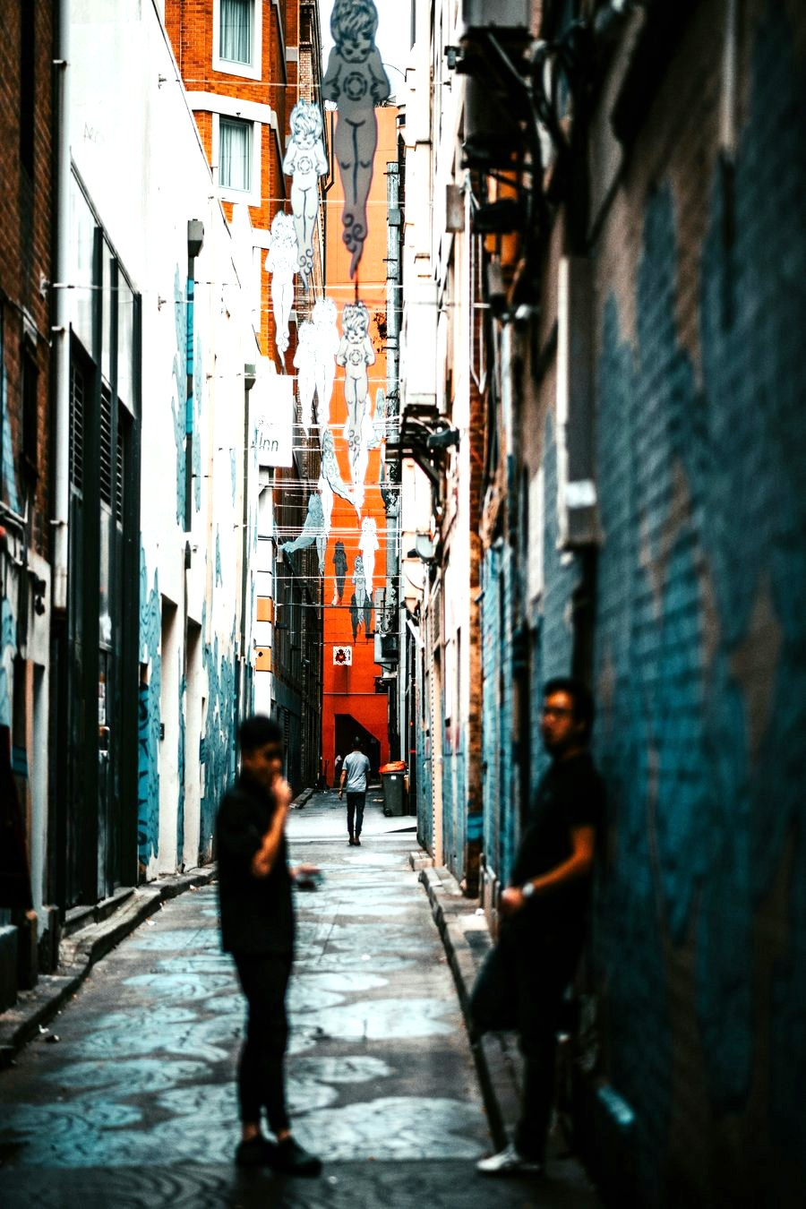
CAST
CONCEPTUAL CASTING
ANGELA "ANGE" PARRELLI
LEAD
DWAYNE MADDOX
ANTAG.
FEMALE LEAD
ANTAGONIST
38. Foul-mouthed, magnetic, smarter than anyone in the room. A fierce, wounded mother.
52. Charming, manipulative, transactional. Meth and Jack Daniel’s push dangerous toward volatile.
JUDGE KAMINSKI
JUDGE
ROGER DURAN
ALLY
THE MIDNITE VIGILANTE
ALLY
60. Composed, razor-sharp moral absolutist. Process and justice are not the same thing.
82. Ex-heavyweight from London. Night-cab driver, Nietzsche at breakfast. Ange’s confidant.
RAVEN
FIANCÉE
JOHNSON · ZIMMERMANN · SILK
TEAM
MADDOX’S FIANCÉE
THE DETECTIVE TEAM
18. Plays the part Maddox wants. Not naive — trapped, and she knows the difference.
30, 25 & 22. Silk’s sister was killed by a man who violated his AVO three times, without consequence.
MICHAEL EGAN | SERIES CREATOR

Slide 8
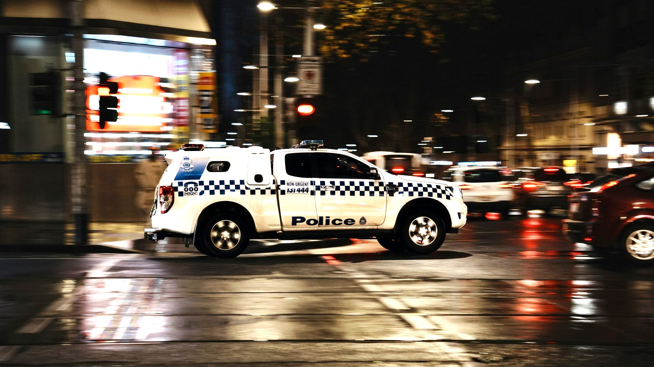
SEASON ONE
A serial killer is executing men across Sydney. Detective Ange Parrelli is assigned to catch them. She is brilliant, self-destructive, and walking into the worst year of her life — losing her daughter, losing the fight against her own addiction, and losing her objectivity about a killer she is supposed to want behind bars.
Early episodes establish the killings and Ange’s unravelling mental health, custody, addiction, and a collapsed operation that nearly gets her killed.
Mid-season widens the world. Public opinion fractures around the vigilante, copycats emerge, and Ange’s obsession with the case becomes something harder to categorise as professional duty.
By the end of season one, the personal and the investigation have collapsed into each other, and Ange must confront the vigilante, her ex-husband, and her demons.
MICHAEL EGAN | SERIES CREATOR

Slide 9
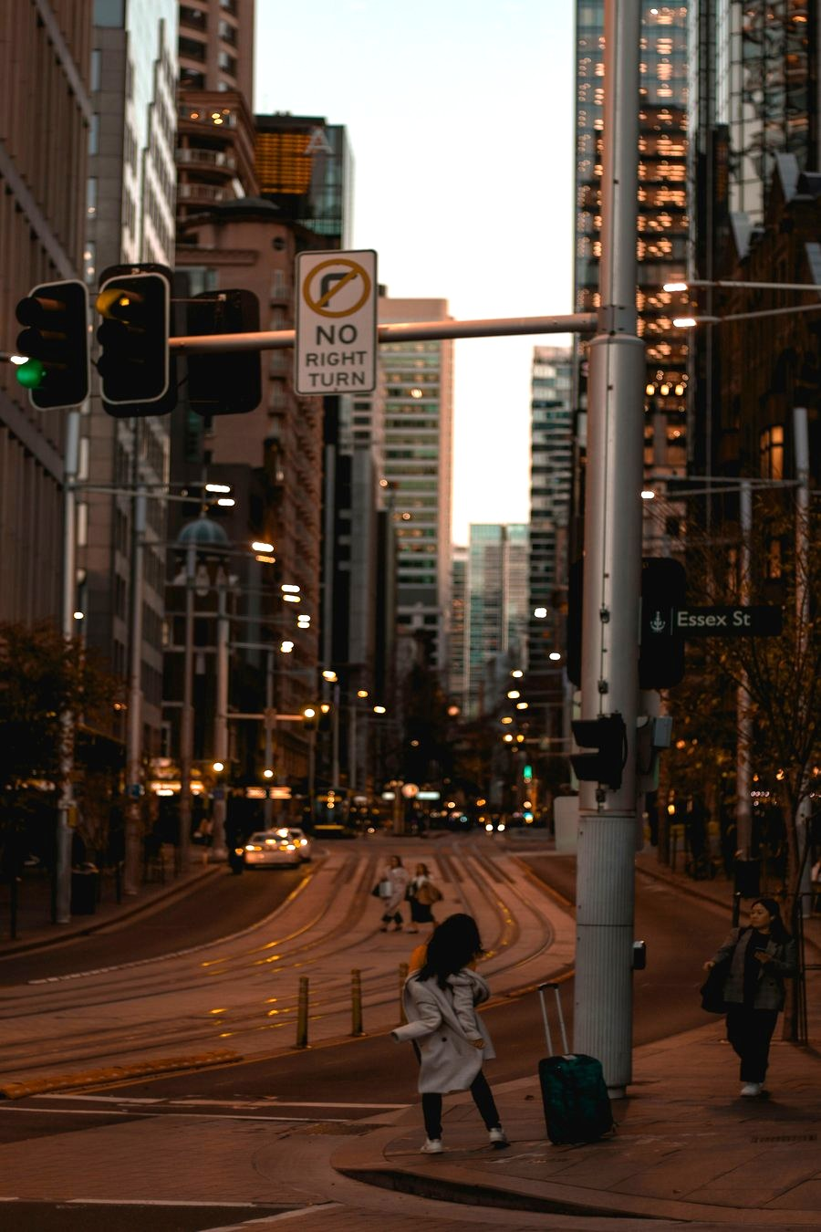
FUTURE EPISODES
Season Two: Copycats rise and the Vigilante becomes a martyr figure. Institutions close in, and Ange navigates systemic blowback while fighting to reclaim her daughter.
Season Three: The violence expands internationally. Ange faces organised crime networks, deep corruption, and her own breaking point.
Season Four and Beyond: Tightrope evolves into a broader cat-and-mouse narrative — retaining procedural hooks while deepening character arcs and exploring the long-term moral fallout of vigilante justice.
MICHAEL EGAN | SERIES CREATOR

Slide 10
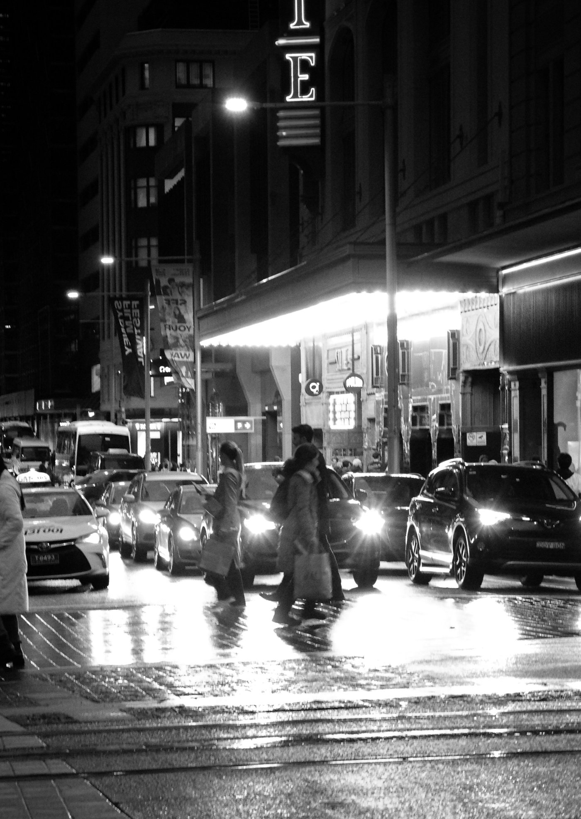
CREATED BY
MICHAEL EGAN
Michael Egan is an Australian writer and filmmaker. Tightrope is his original series — a project years in the making, drawing on deep research into Sydney's criminal landscape, the failures of the family court system, and the psychology of vigilantism.
The series combines hard-boiled noir atmosphere with authentic Aussie voice, built around a female protagonist who is as flawed and compelling as the world she navigates.
REPRESENTATION
STU ARBURY | RAMO LAW
(310) 284-3494 | stu@ramolaw.com

Slide 11
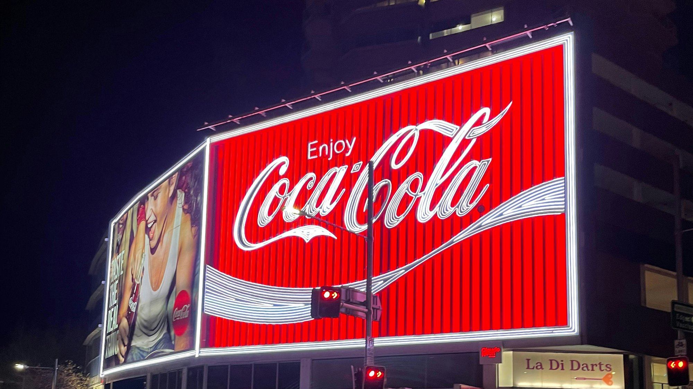
TIGHTROPE
THANK YOU
For further information, please contact:
STU ARBURY | RAMO LAW
(310) 284-3494 | stu@ramolaw.com
© 2026 Michael Egan. All rights reserved.

