Slide 1
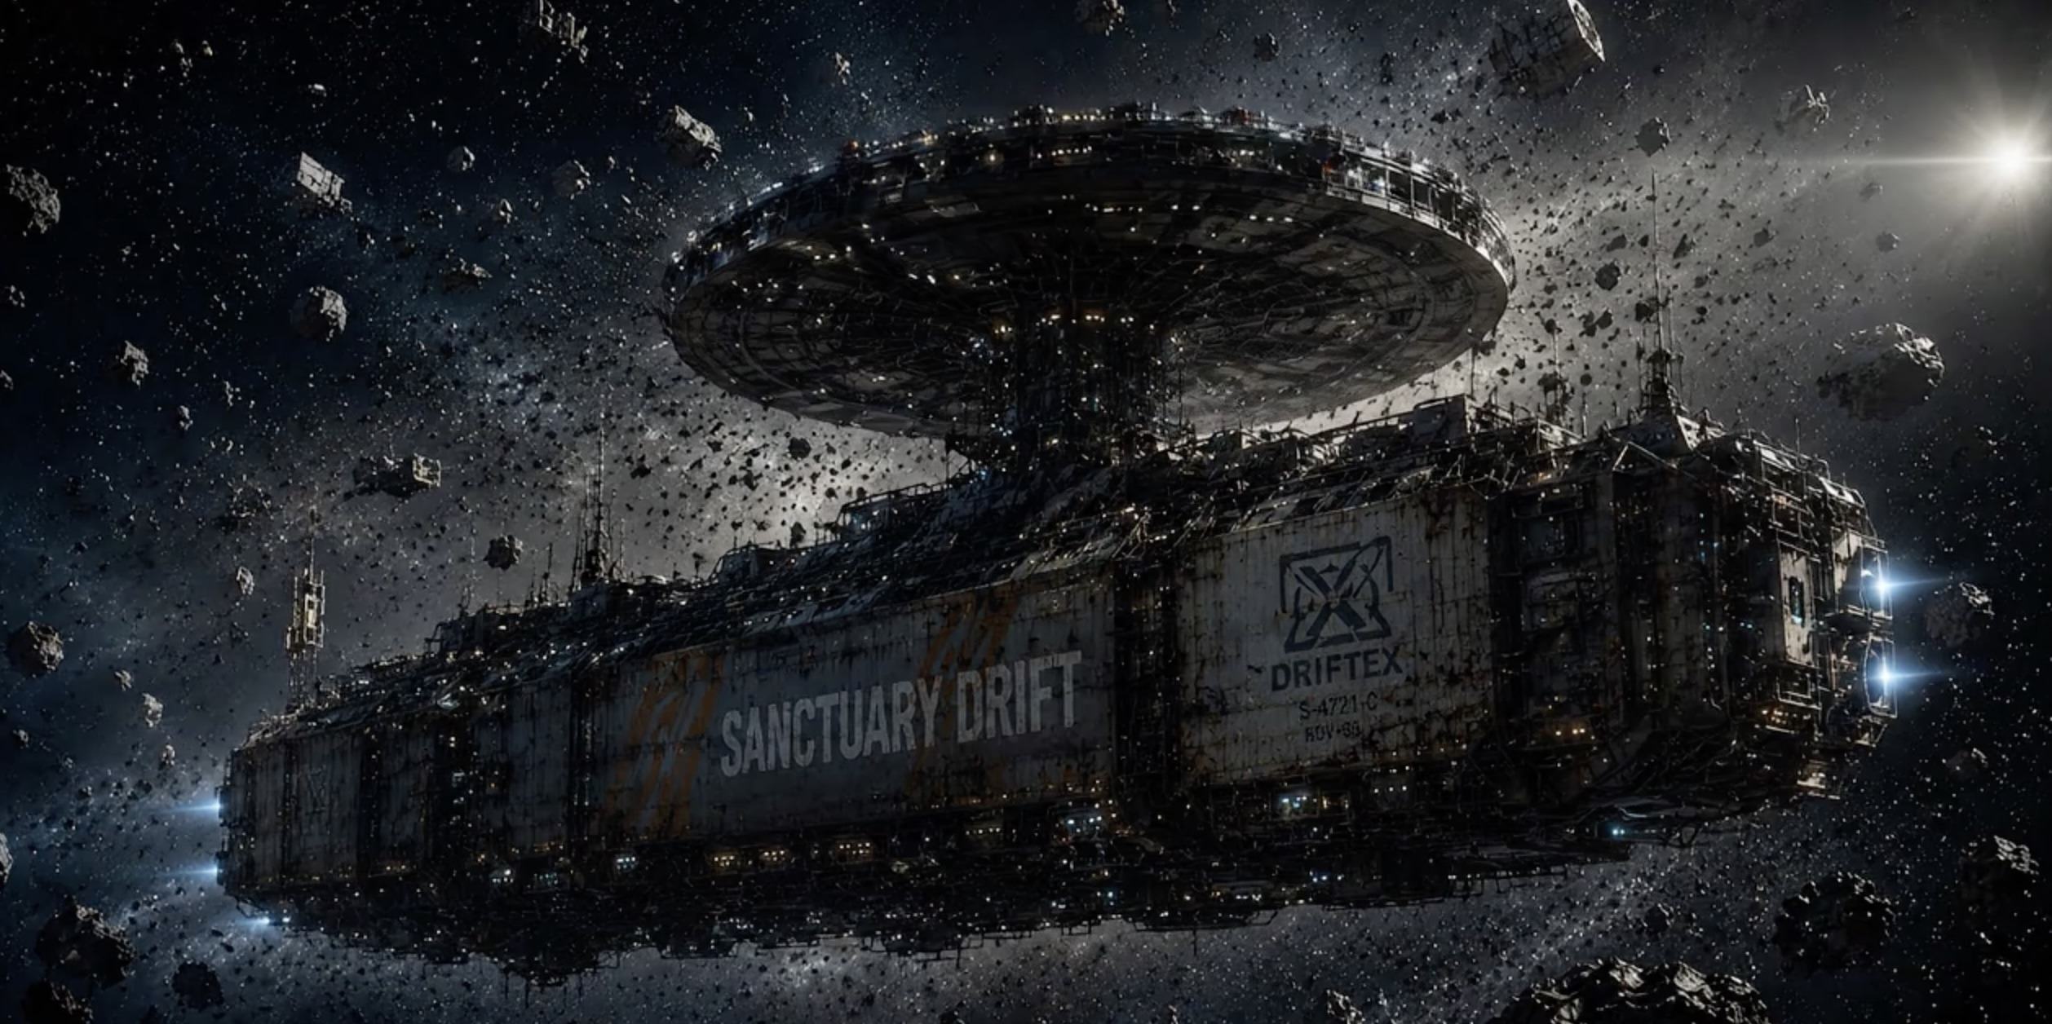

FILMGATE FILMS · AKKA CREATIVE PRESENT
MOTHER LODE
Every salvage has a price.
A feature film · Story by Sean Wheelan · Written by Michael Egan

Slide 2
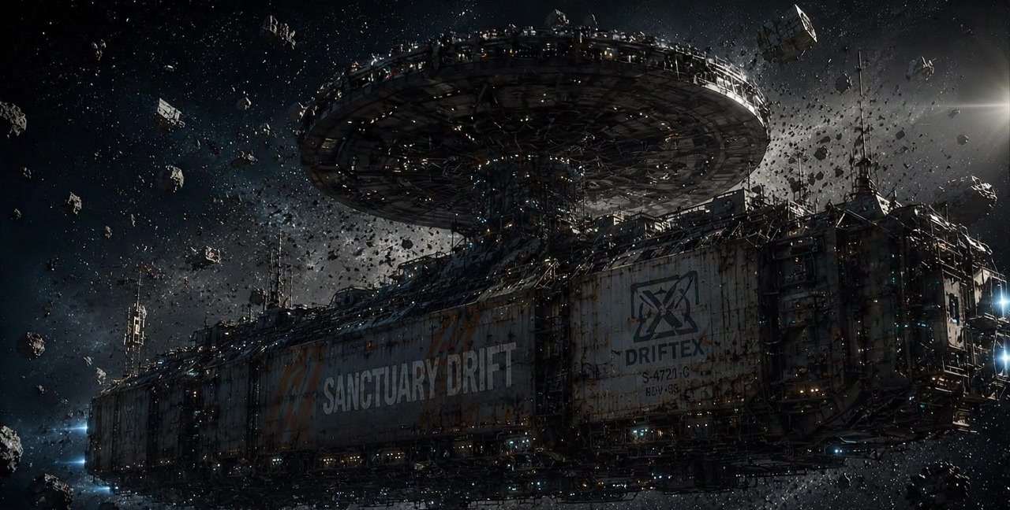


LOGLINE
On the last day of a thousand-day mission, a deep-space salvage crew finds a fortune in alien ore — and one living survivor their company will declare non-human for the right price.
Driftex Salvage Freighter ‘Sanctuary Drift’ · Outer Kuiper Belt · 2105

Slide 3
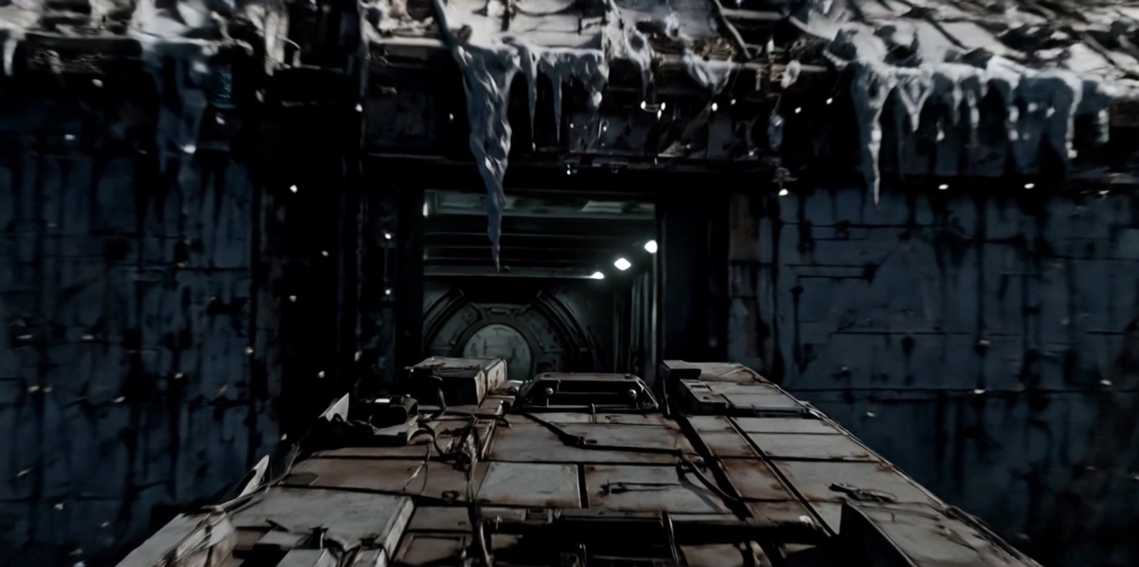

THE WORLD
Two dollars a day,
for a thousand days.
2105. The Sanctuary Drift drags wreckage through an on-board smelter at the outer edge of the solar system. After 999 days, Captain Jax Moran and his six remaining crew are one day from home.
A corporate-dystopian, retro-future, blue-collar world — koala-shaped AI Mercury reciting wellness platitudes; an overseer who fines the crew for swearing; a song the worker sings back to the company that owns him.

Slide 4
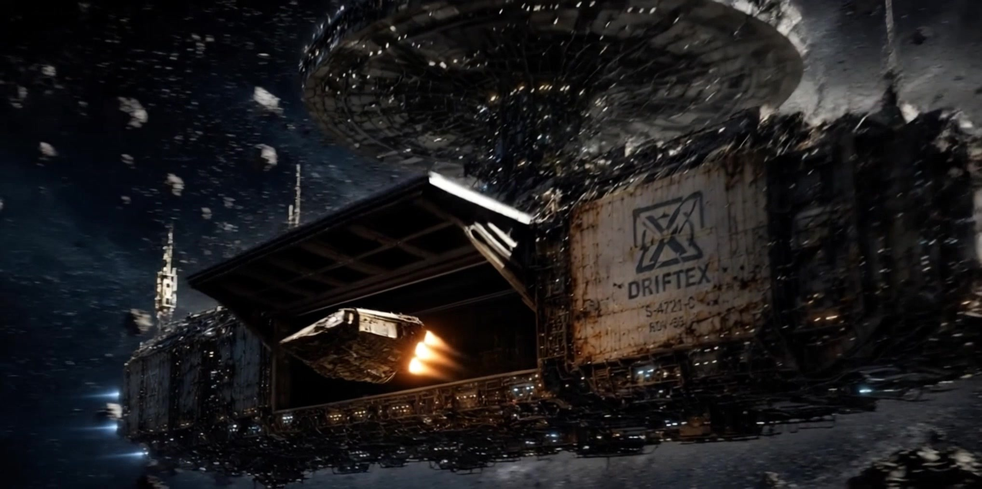
THE ENGINE
How does a corporation kill someone —
and not be guilty of murder?
The answer, every time, is language. A redefinition. An article of space law that sounds too plausible.
“Define alien.”
“Not from Earth. Not us.”
“Posterior probability the entity is non-terrestrial?”
“97.4 percent.”
“So we can’t get done for murder if we kill it.”
“The entity does not satisfy the legal definition of human.”
“When in doubt — throw out.”

Slide 5
TONE & REGISTER
Not a sci-fi movie.
A labour film with a spaceship in it.
01
02
03
04
ALIEN
SORRY TO BOTHER YOU
SUNSHINE
THE COEN BROTHERS
The working-class crew of the freighter
The corporate gaslighting
The existential weight of deep space
The deadpan accumulation of doom
Black satire held in the same shot as blue-collar realism. The violence, when it comes, is operatic and brief — never stylised.

Slide 6
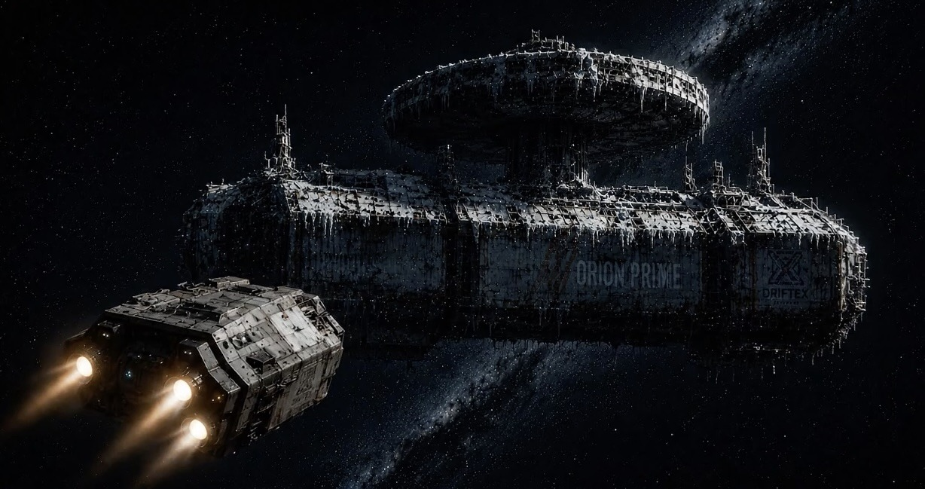
THE STORY
A distress signal, twenty-seven years late.
The Orion Prime, a Driftex ship lost twenty-seven years ago, reappears with its crew dead and its cargo classified: forty thousand tonnes of weapons-grade ore worth six hundred thousand dollars to each crew member in salvage. Inside, among ten picked-clean skeletons, one frozen body. He thaws. He speaks — with a broad Australian accent absorbed from the long-dead crew that captured him.
As the ship’s AI works to redefine him as non-human and clear a legal path to kill him, the crew turn on him, on each other, and on the company. Only one of them refuses.

Slide 7
THE CREW
Seven workers. One company. One survivor.
TEX
CAPT. JAX MORAN
Engineer — the one who, when everyone else trades up, does not.
69. Commands the Sanctuary Drift on its final shift.
SAM
PETTERSSON & KOVALENKO
Ship’s medic. Three years since she’s seen her daughters.
Crew who did the math: a thousand days, two dollars a day.
NOBLE
MERCURY
Corporate overseer. Fines the crew for swearing.
The koala-shaped AI that launders every killing into compliance.

Slide 8
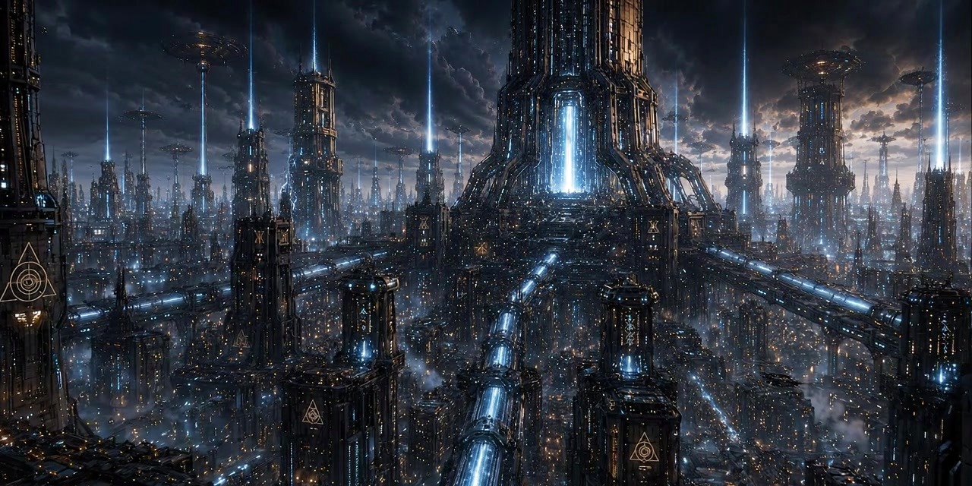


FIRST CONTACT
KEN
His planet runs on the ore. His team found the seam. Stranded twenty-five years, he survived the only way left to him. Without the ore, two hundred and fifty million people on his world die.
“Too human to be killed under any honest definition — and too commercially valuable to be allowed to live.”

Slide 9
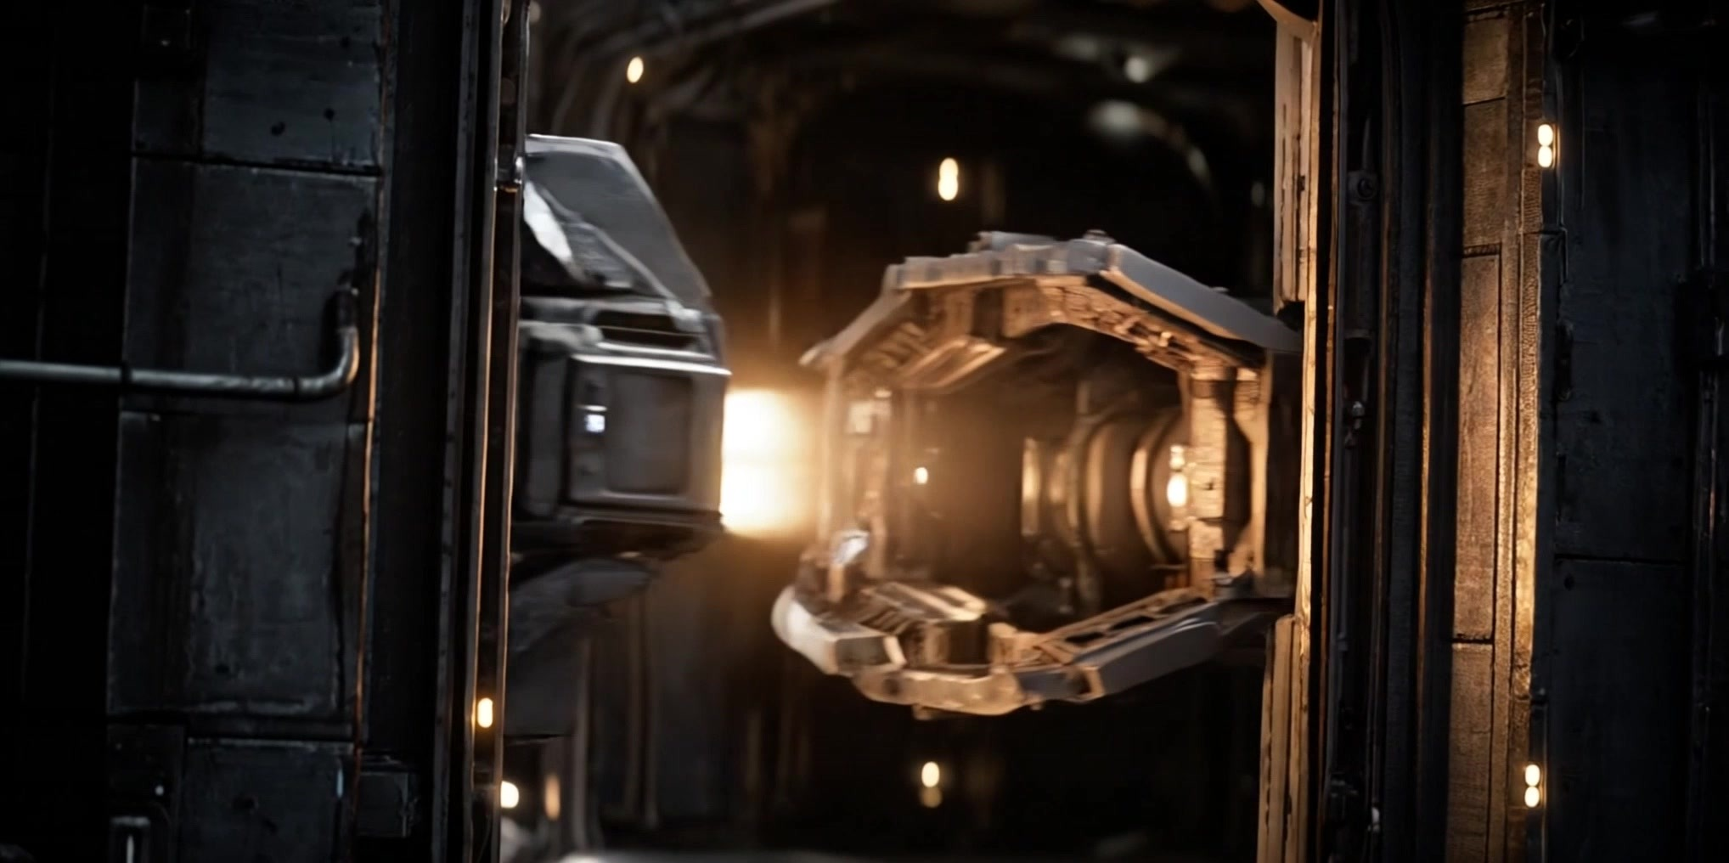

ON THE PAGE
Three scenes that hold the whole film.
OVERTURE pp. 2–7
Sixteen Tons under a koala AI; a widow beats a vending machine open with a wrench. Tone, voice, world and theme arrive in a single breath.
DEFINITION pp. 37–39
“Define alien.” Bureaucratic logic walked all the way to its monstrous conclusion — half Coen Brothers, half Parasite.
THE PENCIL pp. 57–58
A fifty-page setup pays off in a single image — and the AI launders the killing into corporate compliance in the next breath.

Slide 10
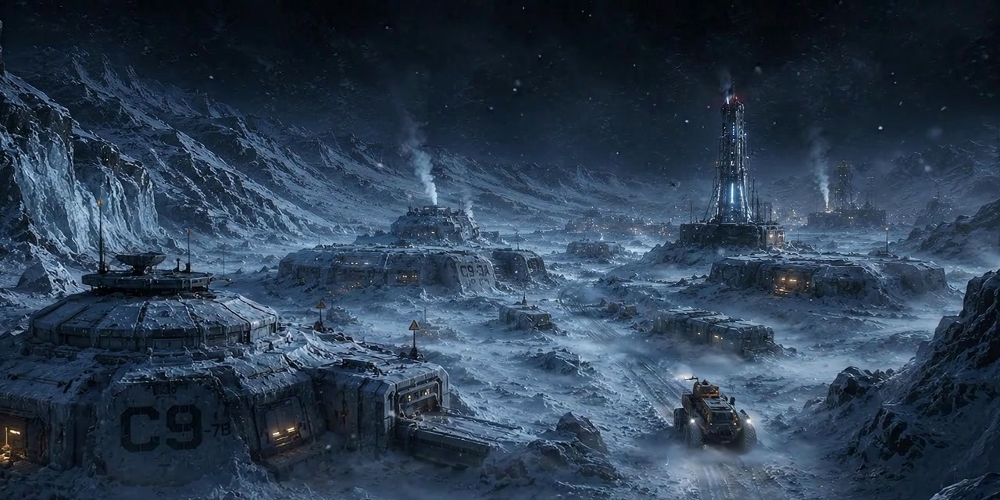
DIRECTOR’S VISION
A workplace before it’s a spaceship.
We are looking for a director who can hold two registers in the same shot: the lived-in physicality of blue-collar realism, and the calibrated absurdity of black satire. The visual effects should be invisible. The performances should be a true ensemble. The violence, when it comes, operatic and brief.
“I wanted the script to be funny in a way that makes the funniness uncomfortable — and the violence to leave the camera and the survivors stunned.”
— Michael Egan, Writer

Slide 11
THE PACKAGE
Contained by design. Built for the budget.
SINGLE LOCATION
VFX-LED ADVANTAGE
One soundstage. The Sanctuary Drift — bridge, commissary, med bay, corridors, cargo hold — keeps build cost contained.
Space exteriors, the smelter, the ice planet and Mercury carried by Filmgate’s in-house VFX pipeline — structural cost and creative edge.
NORDIC CO-PRODUCTION
A PROVEN HOUSE
A Swedish–Finnish package (Filmgate AB / Akka Creative) built to draw on Nordic soft money and incentives.
Filmgate: 40+ international features — Living, R.M.N., Undergods, The Lair, Tumbbad, Never Look Away.

Slide 12
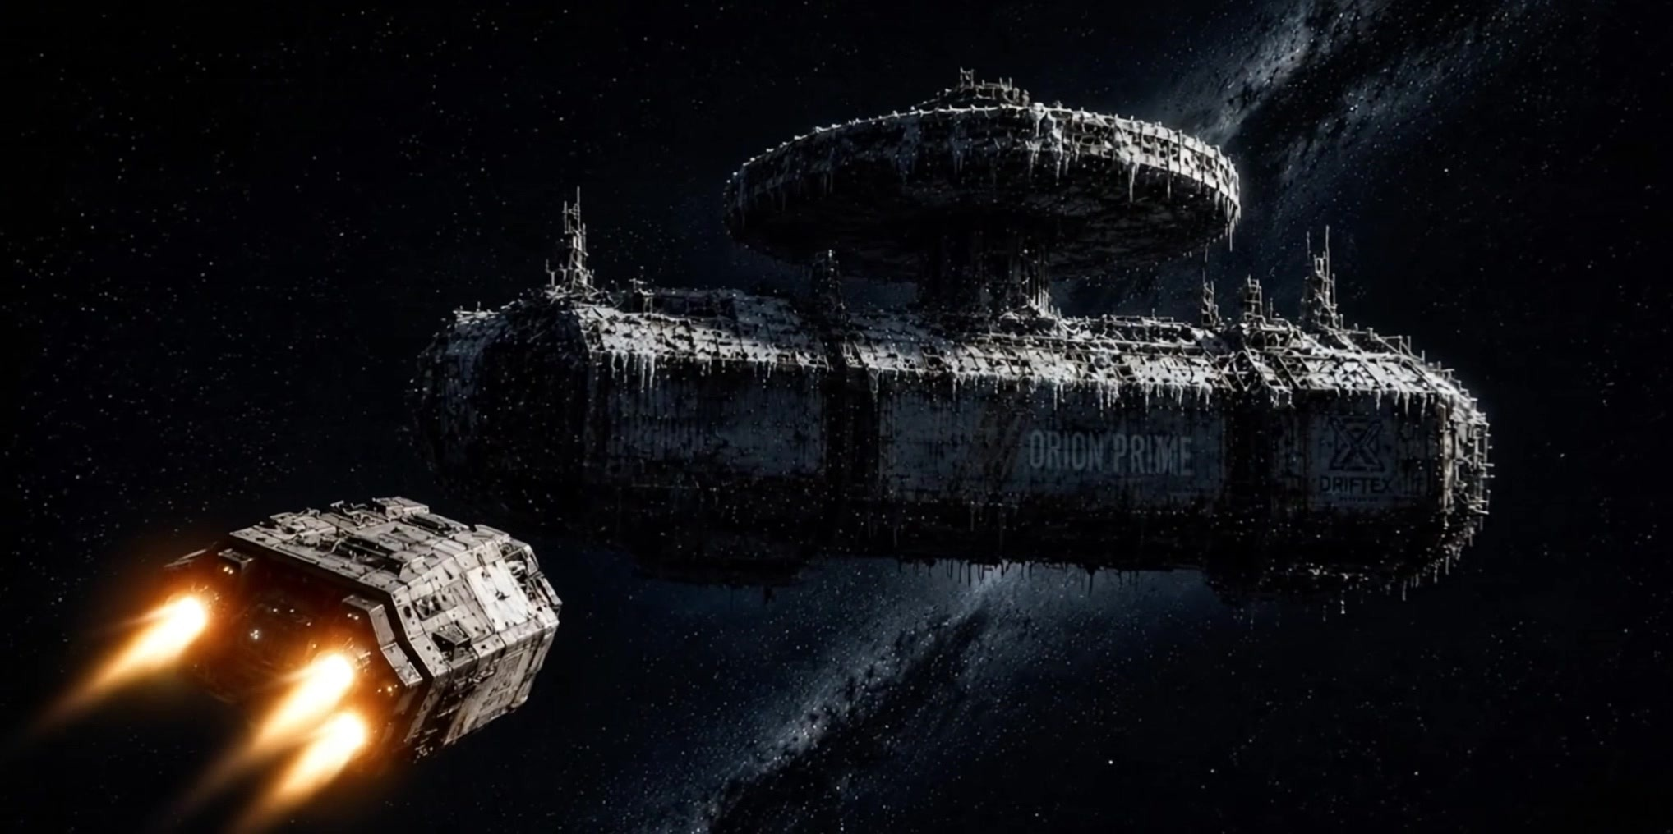
FINANCING
A €2.5M Nordic co-production, soft-money led.
€2.5M
SE-majority
~60%
In-house
TARGET BUDGET
CO-PRODUCTION
SOFT MONEY
VFX PIPELINE
Single-stage shoot, VFX-led
Sweden lead · Finland partner
Regional, national, Nordic & EU
Filmgate VFX — cost + creative edge
Cornerstone: Film i Väst (up to €1M). Stage: packaging — seeking a director and Nordic / international financing partners.
Full budget top-sheet and two-scenario financing plan available on request.

Slide 13
THE TEAM
The people behind Mother Lode.
SEAN WHEELAN
NINA LAURIO
MICHAEL EGAN
PRODUCER · STORY
PRODUCER
WRITER
Founder & CEO, Filmgate Films (Gothenburg). 40+ international co-productions over fifteen years — Living, R.M.N., Undergods, The Lair, Tumbbad. Mother Lode originates from his story.
Founder, Akka Creative (Helsinki). Thirty years in Finnish independent production; Vice President of Audiovisual Producers Finland. Equal co-producer on the Finnish–Swedish package.
Australian writer-director based in Sydney. Writes across registers, from screwball comedy to noir-tinged genre. Developed Mother Lode from Sean Wheelan’s story.

Slide 14
NOW PACKAGING
MOTHER LODE
Every salvage has a price.
Sean Wheelan · Filmgate Films AB · sean@filmgate-films.com
Story by Sean Wheelan · Written by Michael Egan · Produced by Filmgate Films & Akka Creative

